Slide 1

App Guide Template App SageMotion Wearable Biofeedback System

Slide 3
Table of Contents
Components (page 1)
Wirelessly Connect to Computer or Cellphone (page 2)
Template App (page 3)
© SageMotion, 2021. All rights reserved.
App Guide: Raw Data
Information in this document is subject to change without notice.

Slide 4
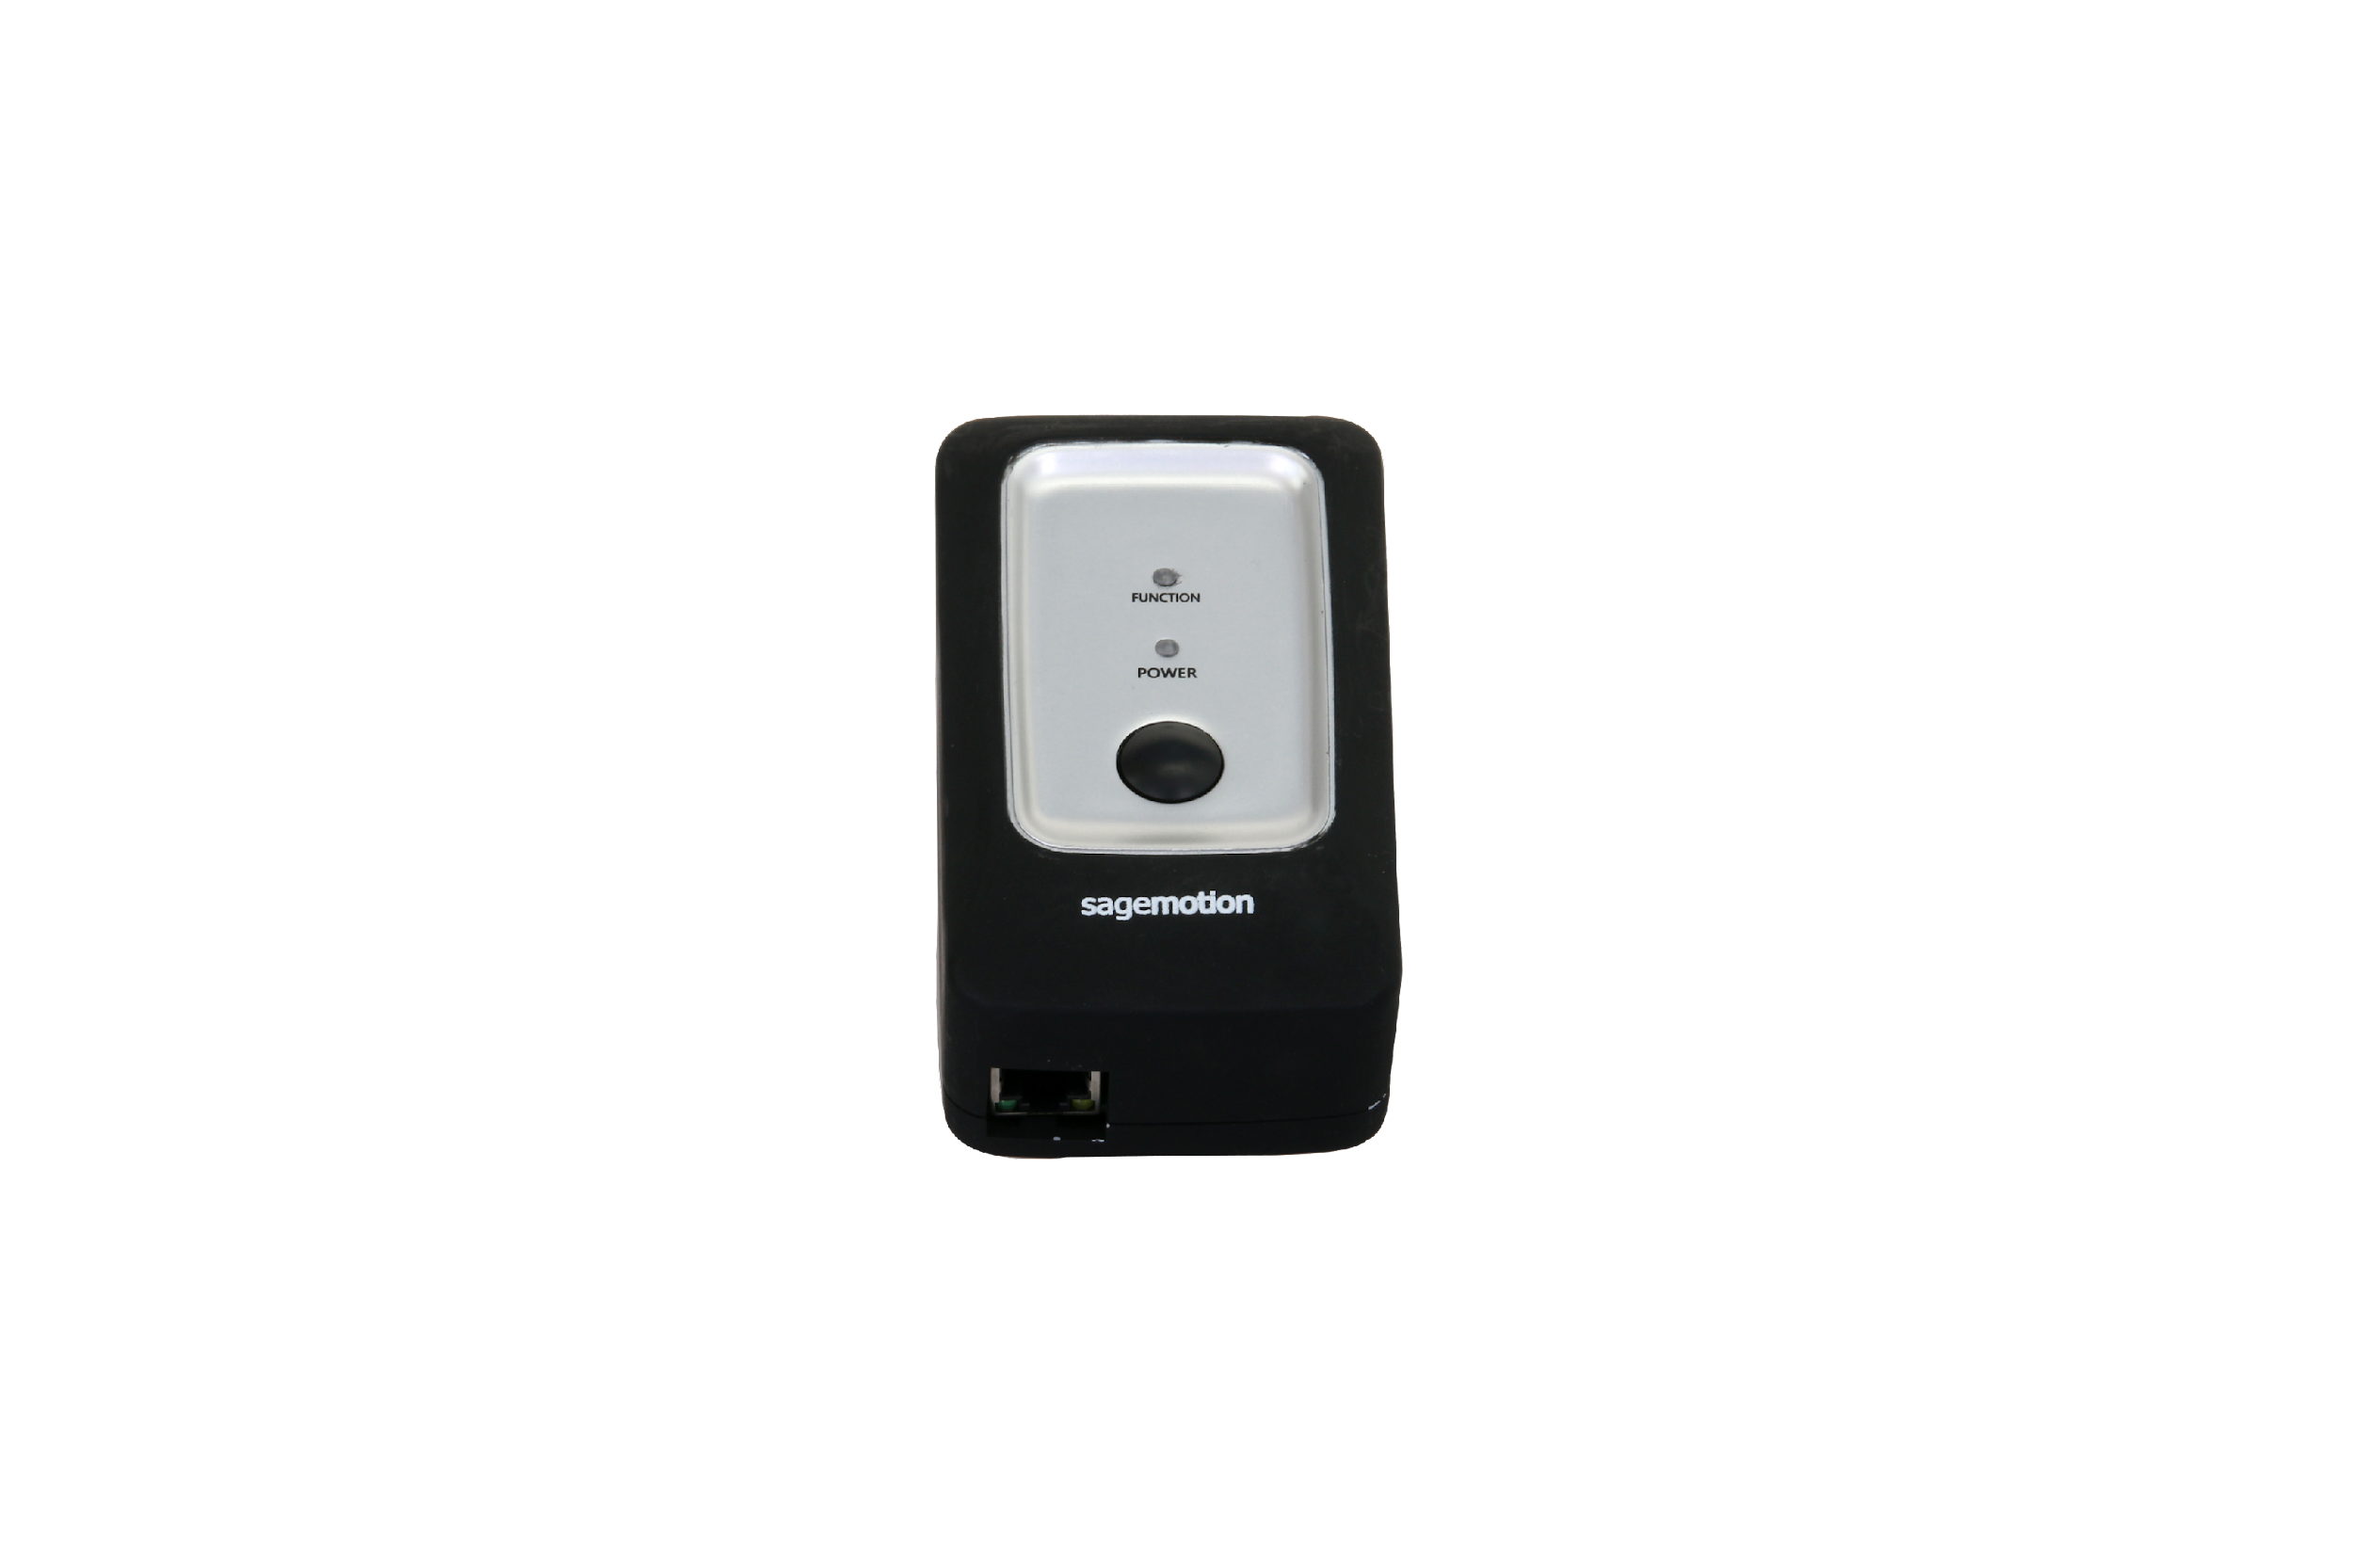
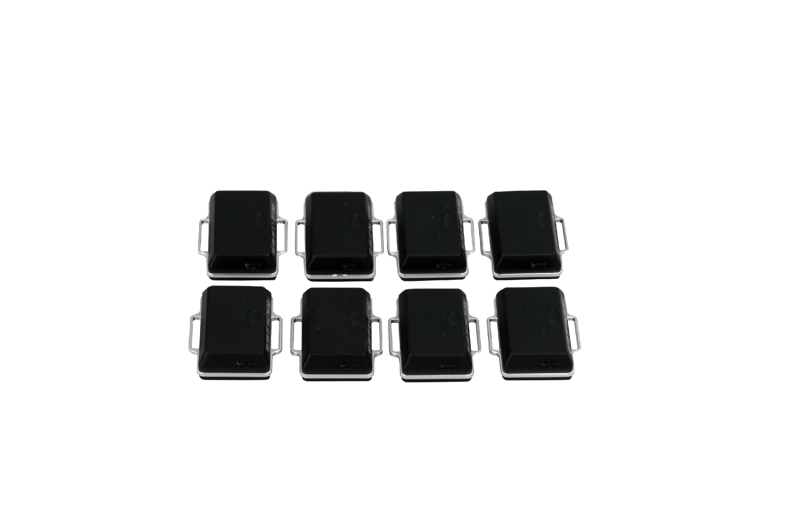
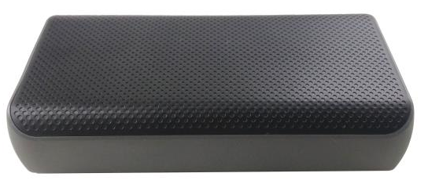
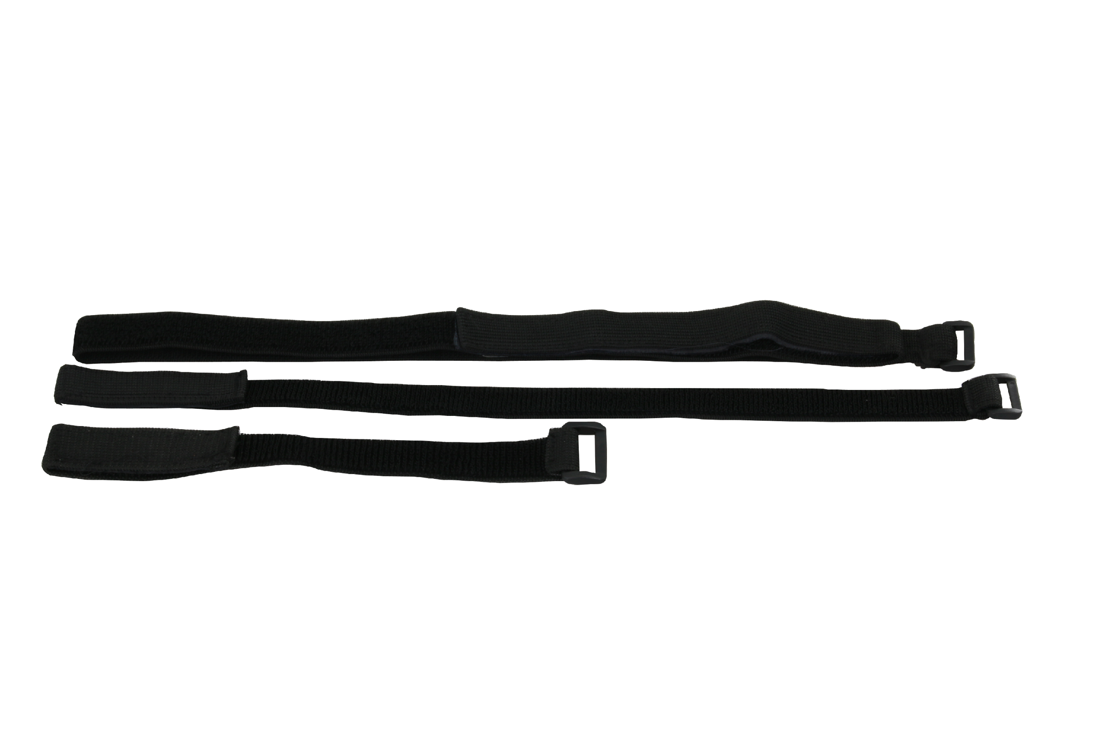
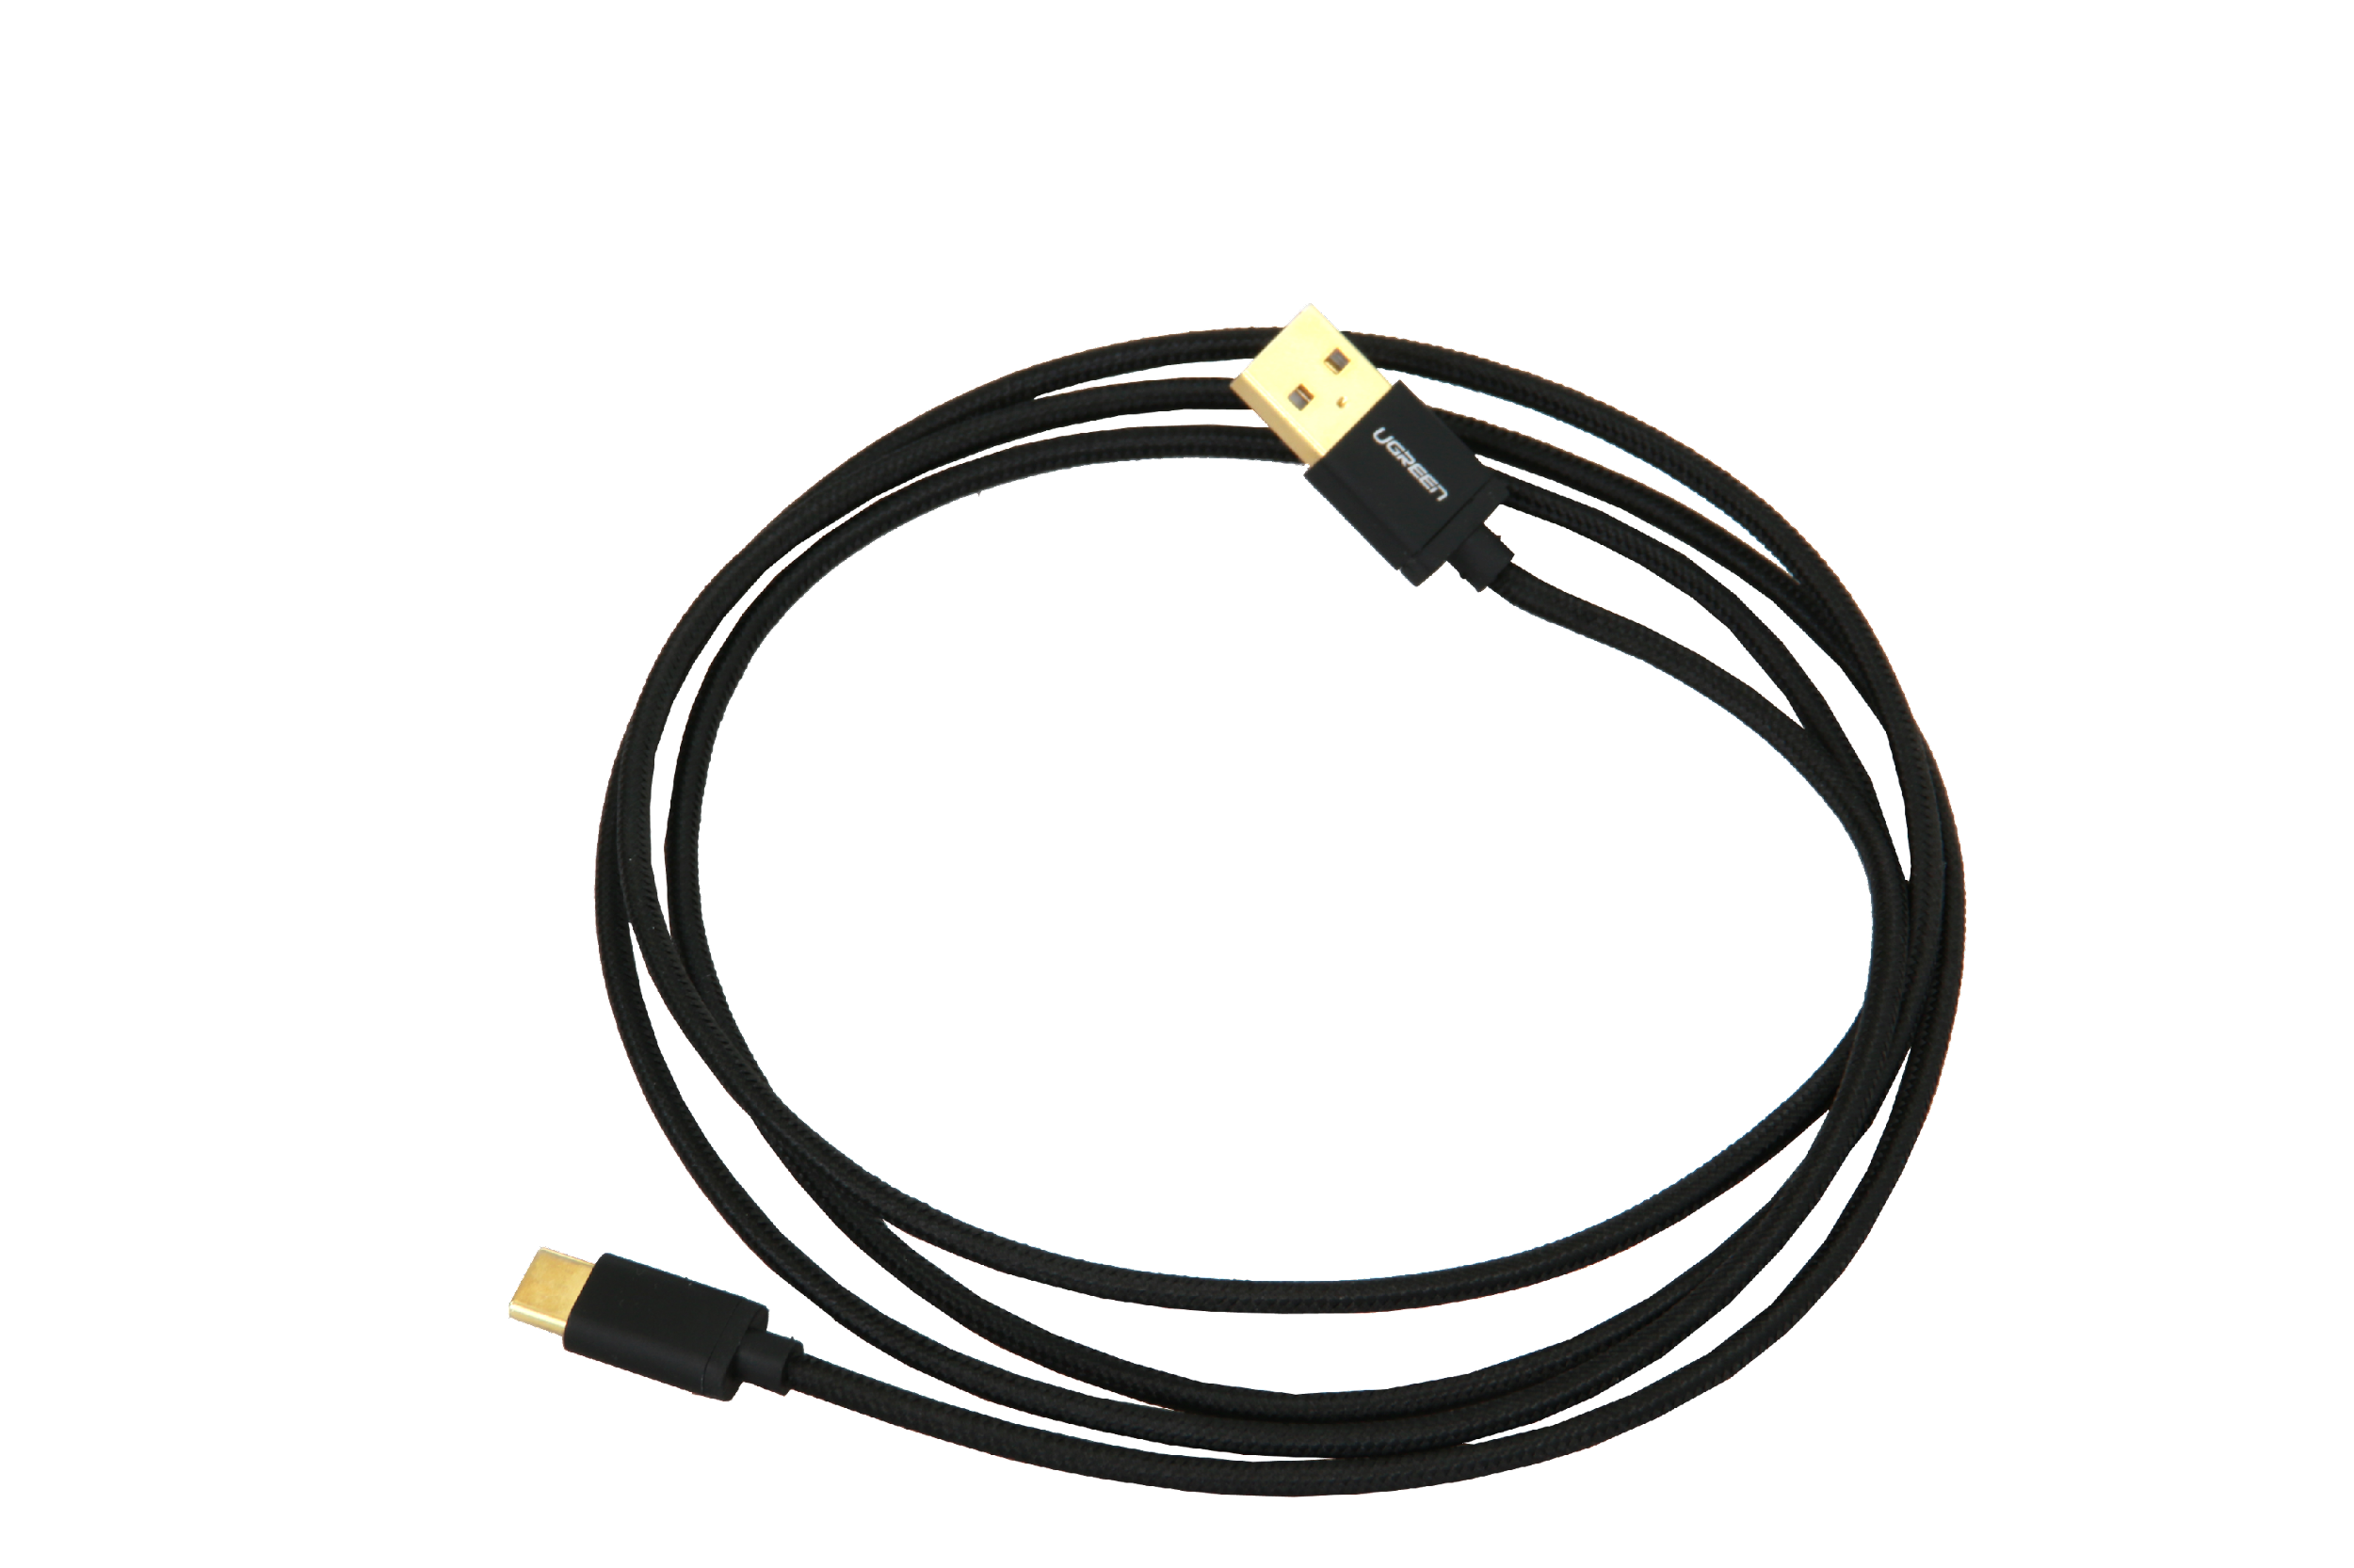
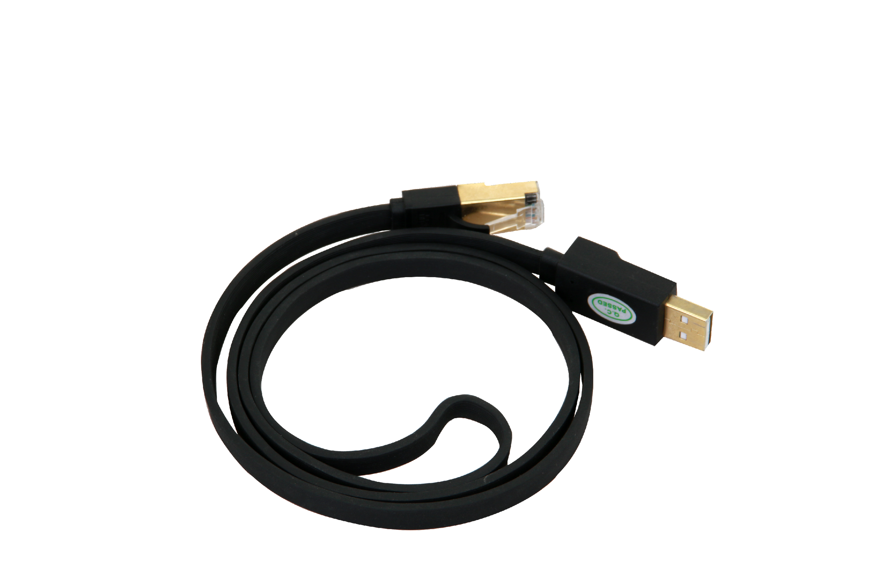
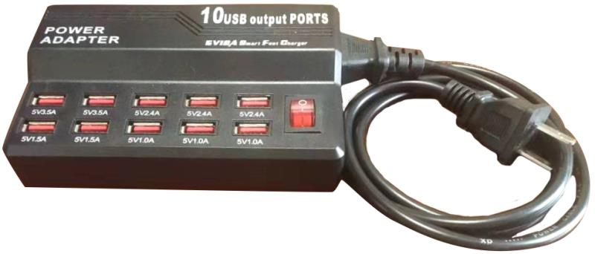
Components
Hub
Nodes (8x)
Battery
Node Straps: Medium (8x), Short (4x), Long (2x)
Cable A (10x)
-Connect Hub to Battery
-Charge Nodes & Battery
Cable B (optional use)
-Connect Hub to Computer
Node Charging Station

Slide 5
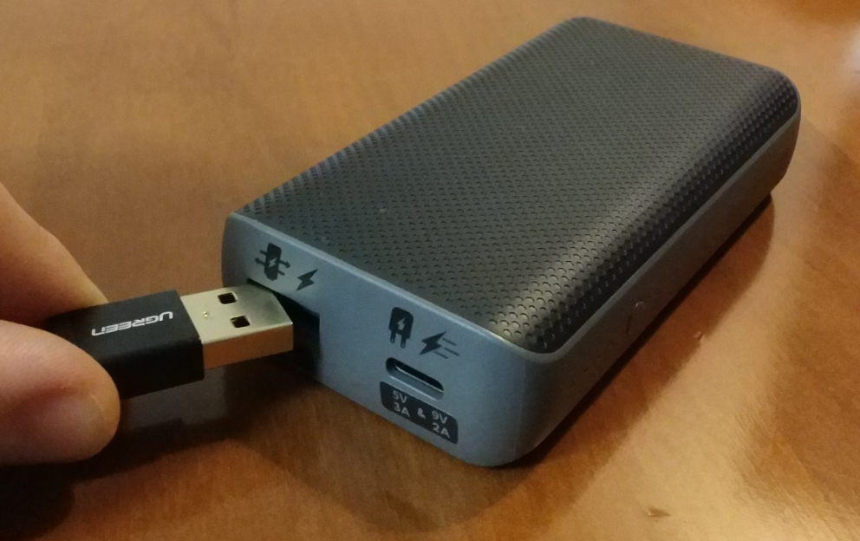
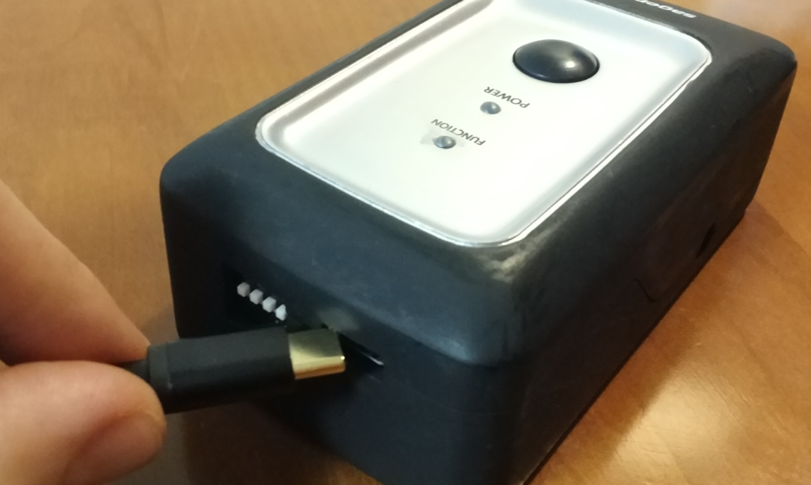

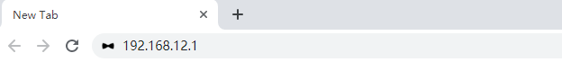
Wirelessly Connect to Computer or Cellphone
1) Connect Cable A to Battery and to Hub
2) On Computer/Cellphone, Connect to Wi-Fi: “SageMotion”
Note 1: Need to wait for up to 1 minute for “SageMotion” to appear in Wi-Fi list. If it doesn’t appear, try turning the Wi-Fi off and then on again on the computer/cellphone.
Note 2: Hub is connected after clicking “Connect” even if in Windows it shows “Connecting” or “No internet, open”.
3) On Computer/Cellphone, in Chrome Address Bar, Go To http://192.168.12.1
[Note] If Computer Doesn’t Have Wi-Fi: plug in Cable B to the Hub and to the ethernet port of your computer, then in chrome address bar, go to http://192.168.137.1

Slide 6
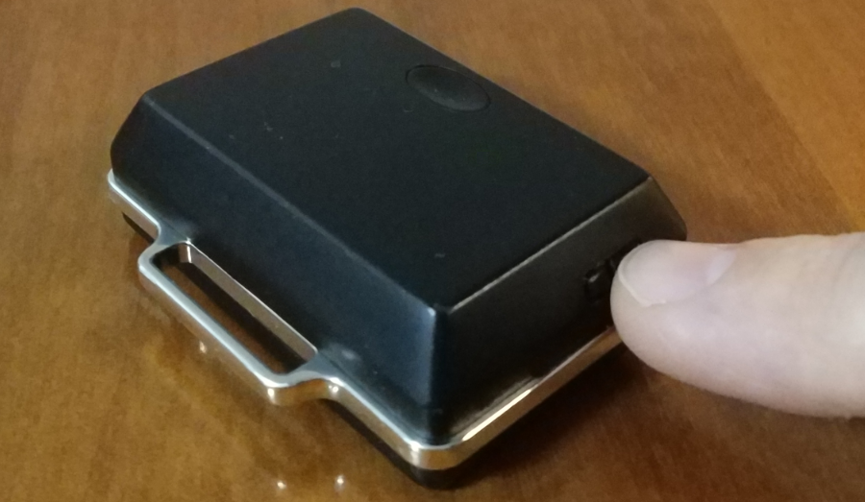
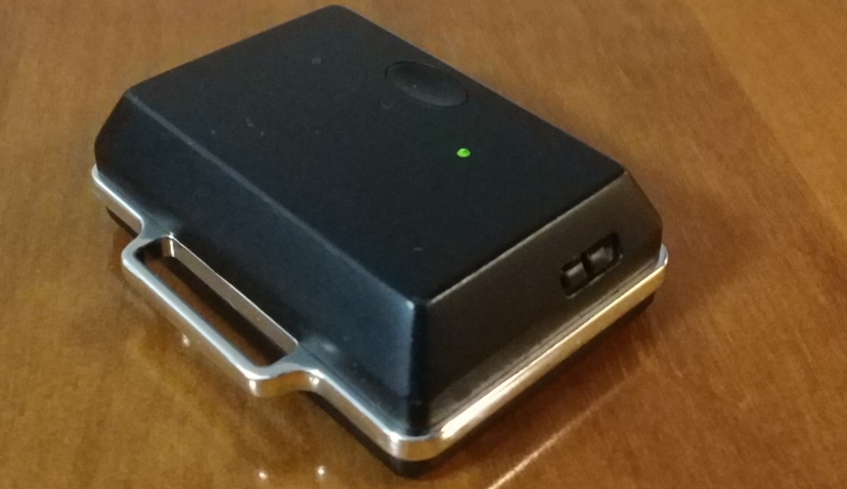
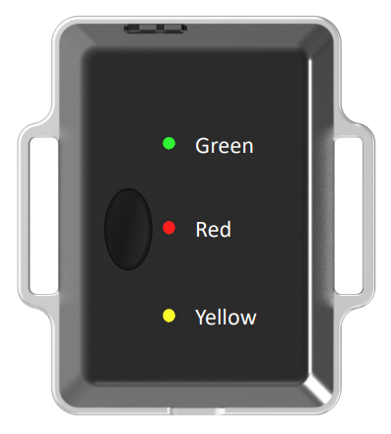
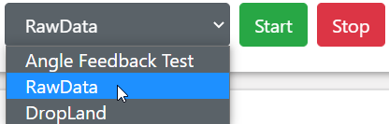
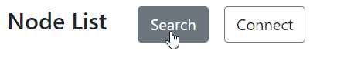
Template App
The purpose of the Template App is to be a starting app for development. The rest of this app guide is from the raw data app
1) Turn on 1 Node
Slide switch toward middle to turn node on
Green light will blink after the node is on and running
Green LED (power and wireless connection)
-ON: Power on, wirelessly connected to hub
-OFF: Power off
-Blinking: Power on, wirelessly disconnected to hub
Red LED (visual interface)
-ON: Sync failure, switch node off then on again
-OFF: Normal operation
-3 Blinks: Triggered from blink button in interface
Yellow LED (battery)
-ON: Battery is charging
-OFF: Battery is full (cable plugged in) or charging cable is unplugged
-Blinking: Battery malfunctioning
2) Select “RawData” App
3) Click “Search”

Slide 7
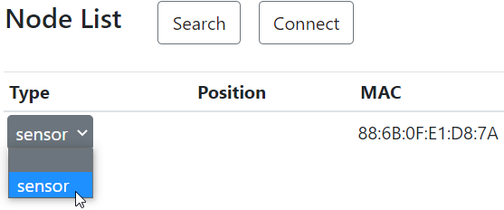
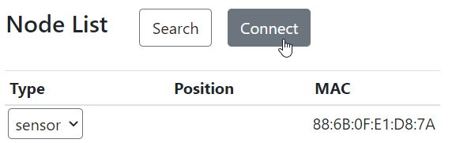
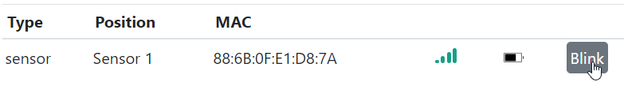
RawData App (cont.)
4) In the Type Dropdown Box, Select “sensor”
Note: 12-digit node ID will match the number in the MAC column
5) Click “Connect”
6) “Ready to collect data” Will Appear after Node Connection Complete
7) Click “Blink” to Test Connection. Red Light on Node Will Blink 3 Times

Slide 8
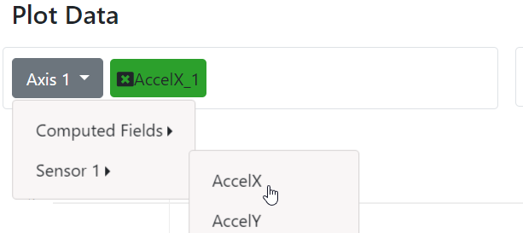
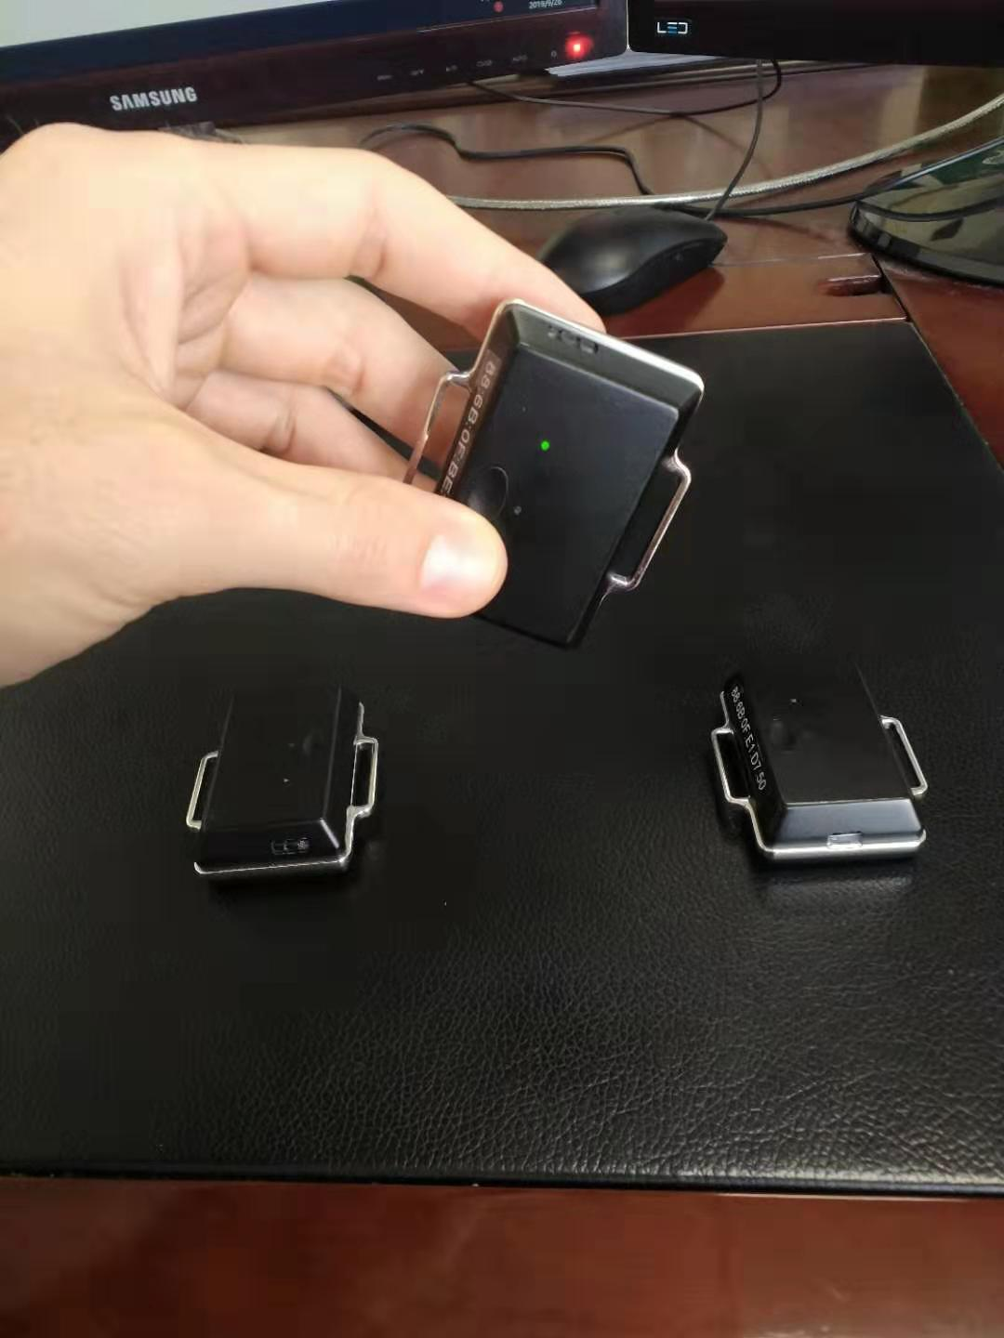
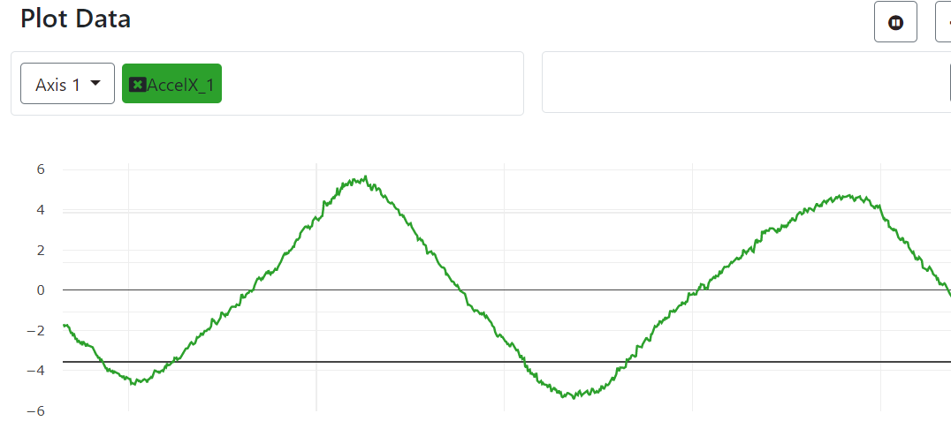
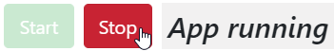
RawData App (cont.)
8) Click “Start” to Start Running App
9) Click Axis 1 > Sensor 1 > AccelX to Plot x-axis Acceleration
10) Rotate Node to the Right and Left in Orientation Shown Below and Observe Real-Time Visual Plotting. When Done, Click “Stop”
RawData App Finished!

